Slide 1

Deep Graph Library Easy Deep Learning on Graphs
Minjie Wang & Lingfan Yu
With DGL Team
New York University, NYU Shanghai, AWS, AWS Shanghai AI Lab
GTC 2019 Instructor-led training (L9134)
https://github.com/dmlc/dgl

Slide 2
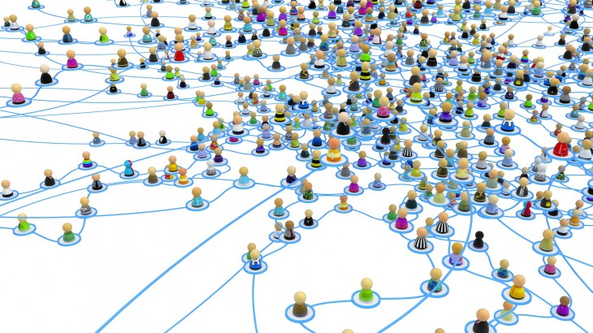
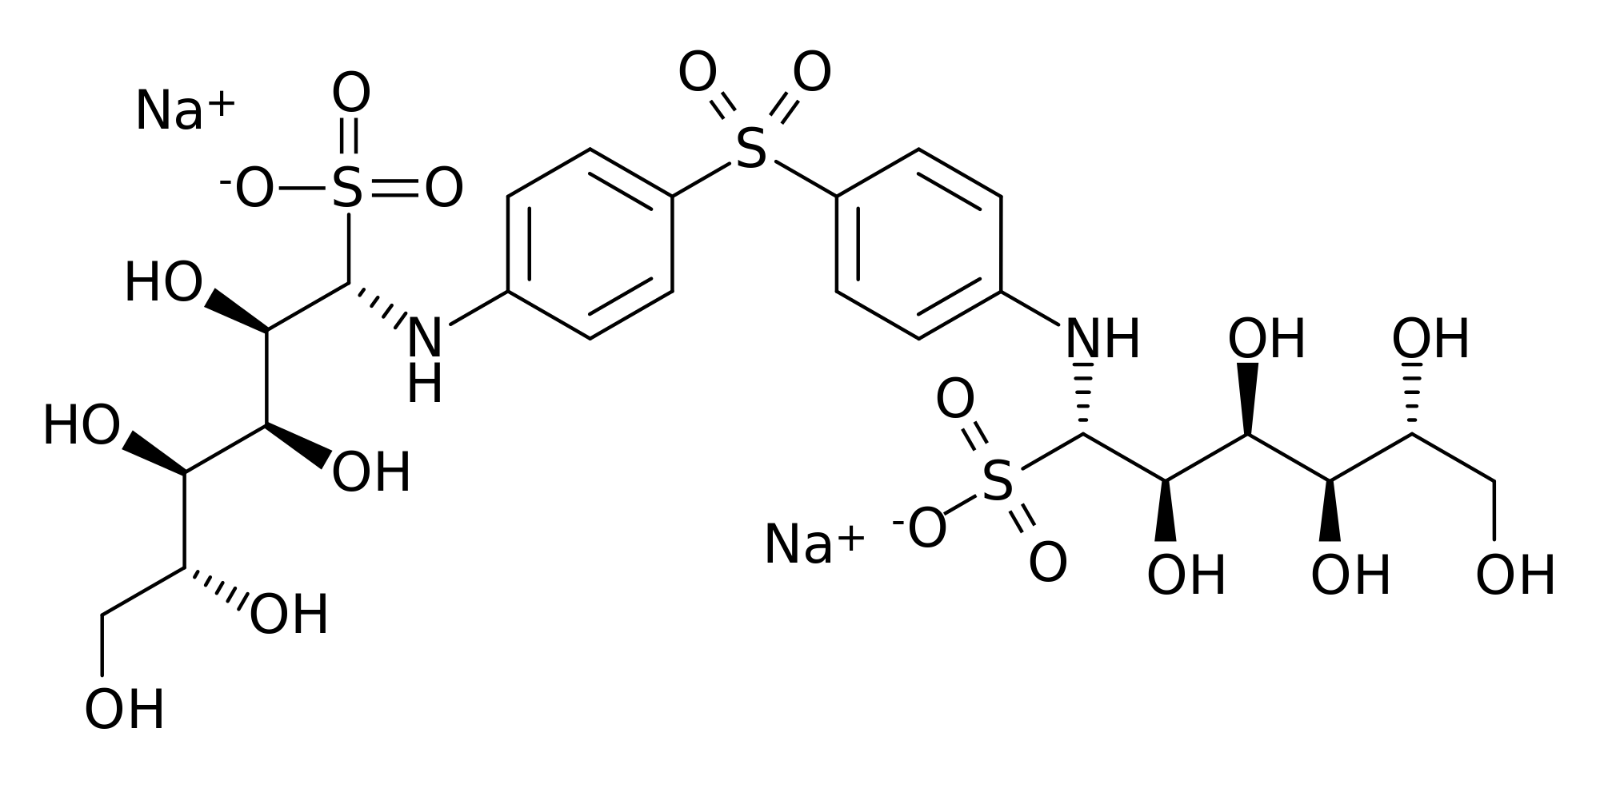
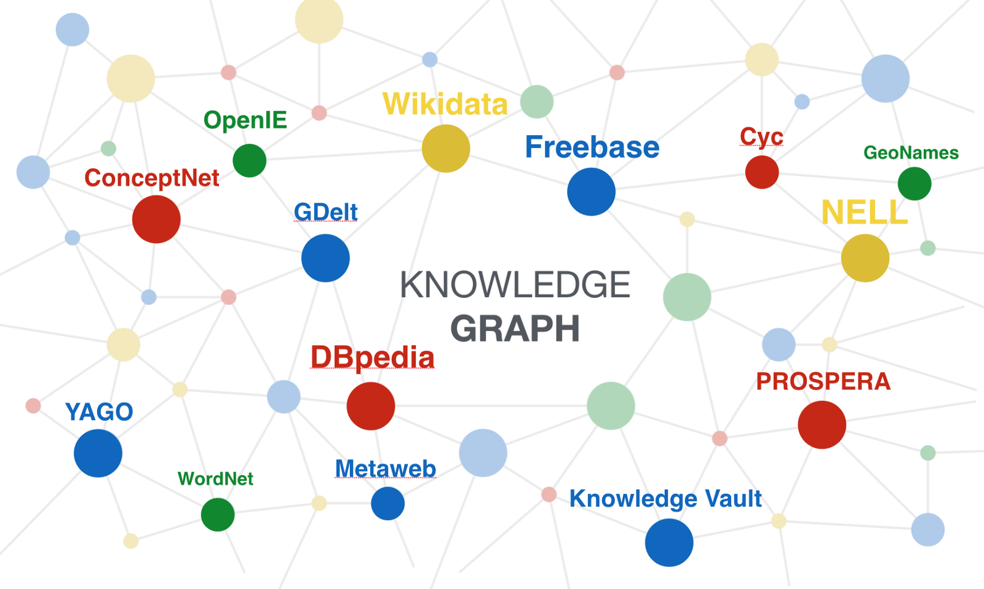
Graph data are everywhere
Graphs are everywhere
Social network
Drugs and new materials
Knowledge graph

Slide 3
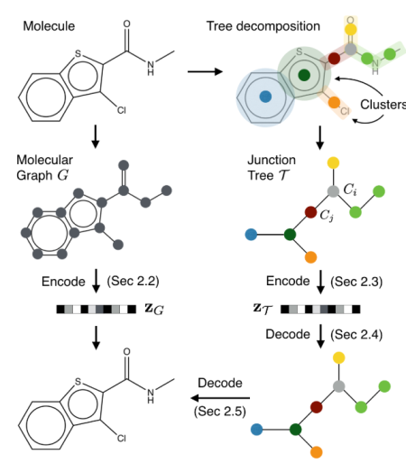
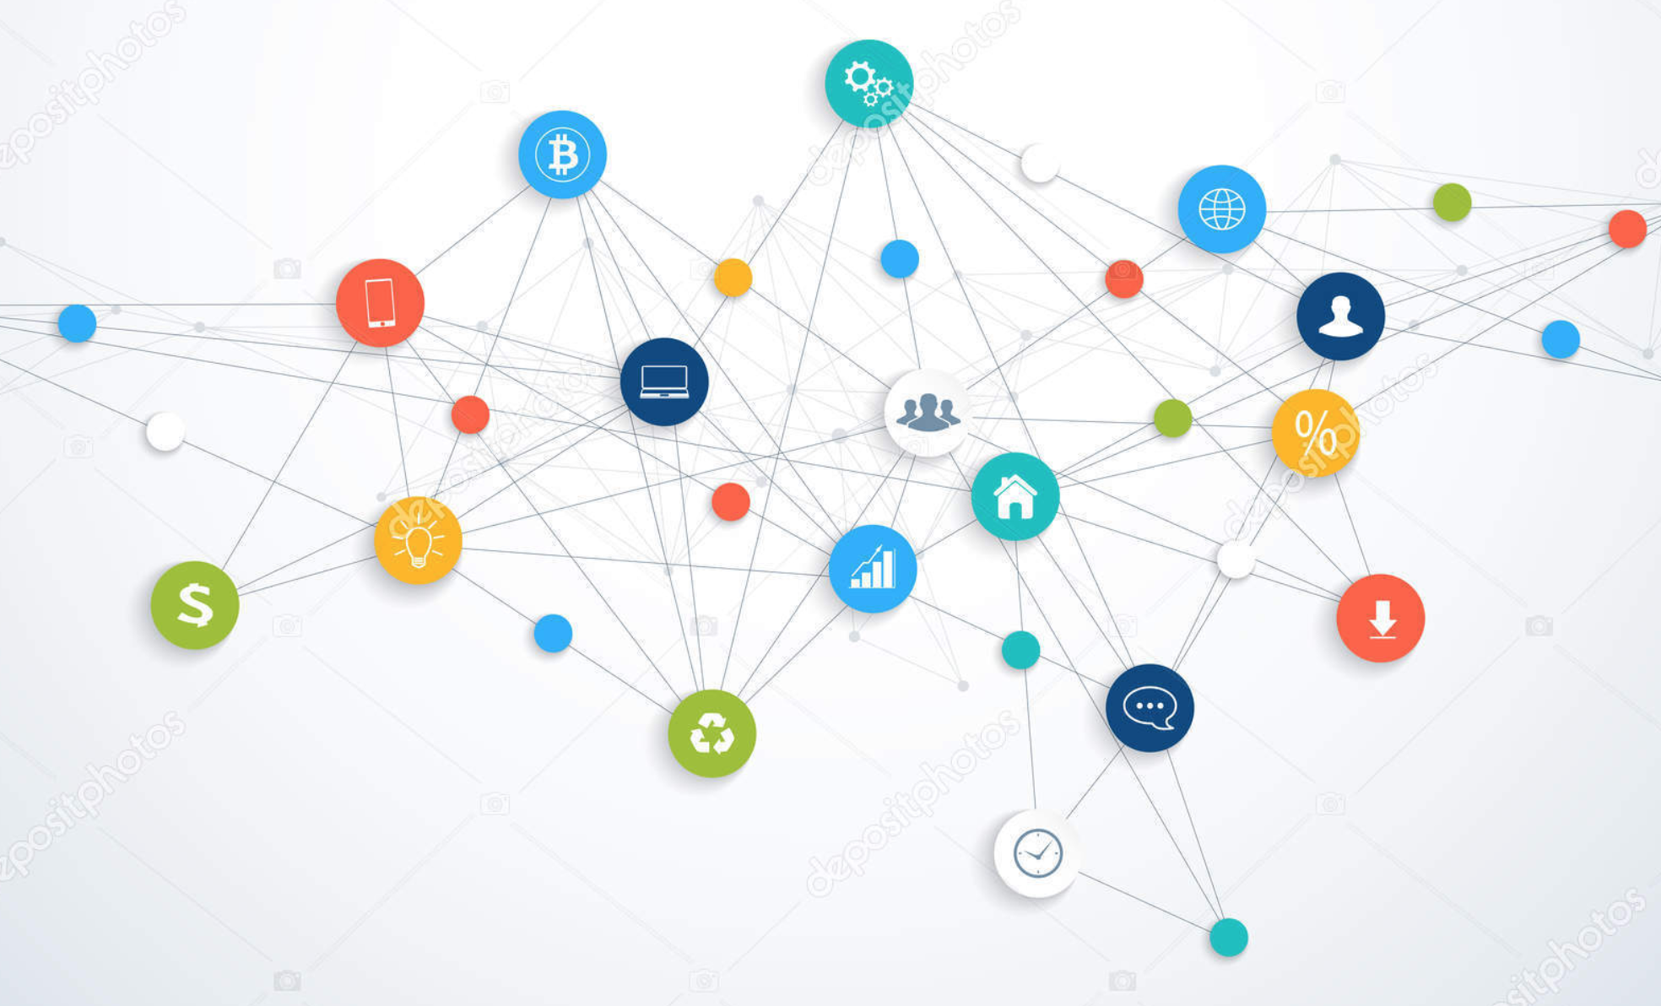
Many ML tasks must learn from graphs
Community detection
Find new molecules
Knowledge base completion
Social Network
[Chen et al. arxiv’18]
Molecule Graph
[Jin et al. ICML’18]
Knowledge Base
[Schlichtkrull et al. arxiv’17]

Slide 4
GNN is emerging class of DL models

Slide 5
What you’ll learn from this tutorial
What is GNN? Why are they widely applicable?
What is DGL? Why DGL? And how DGL makes it easy to write GNN programming?
Hands-on Tutorial:
How to use a GNN model to accomplish to do community detection
How to tune the performance

Slide 6
Community detection
Describe the task with example

Slide 7
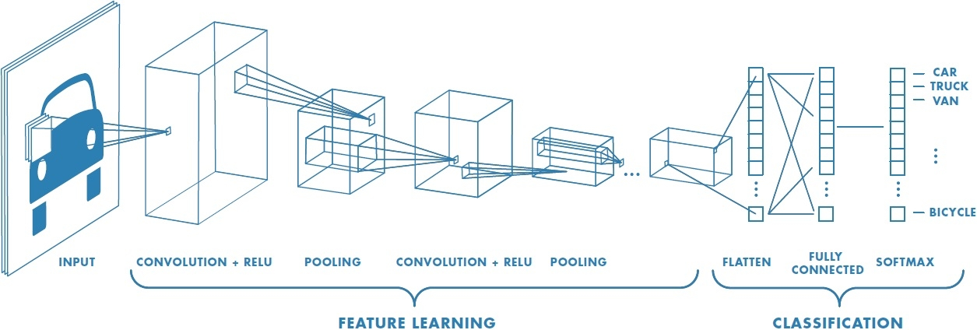
When deep learning meets graph
CNN: learn representation of an image

Slide 8
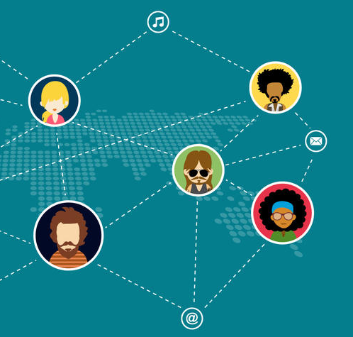
When deep learning meets graph
Graph Neural Network (GNN): learn representation on graph

Slide 9
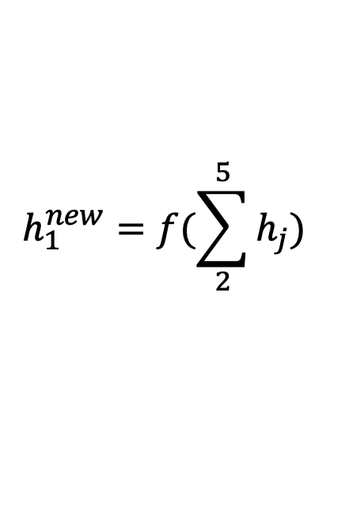
Representation Learning
Generating representation of nodes, which can later be used to predict node properties.
h₅
h₂
v₅
v₂
v₁
$$h_{1}^{new}=f(\sum_{2}^{5}{h_{j}})$$
v₃
v₄
h₄
h₃
Notes:
A new class of neural network has emerged and gained popularity recently
Incorporate relational information

Slide 10
GNN for computational biology
Learning representation for molecules

Slide 11
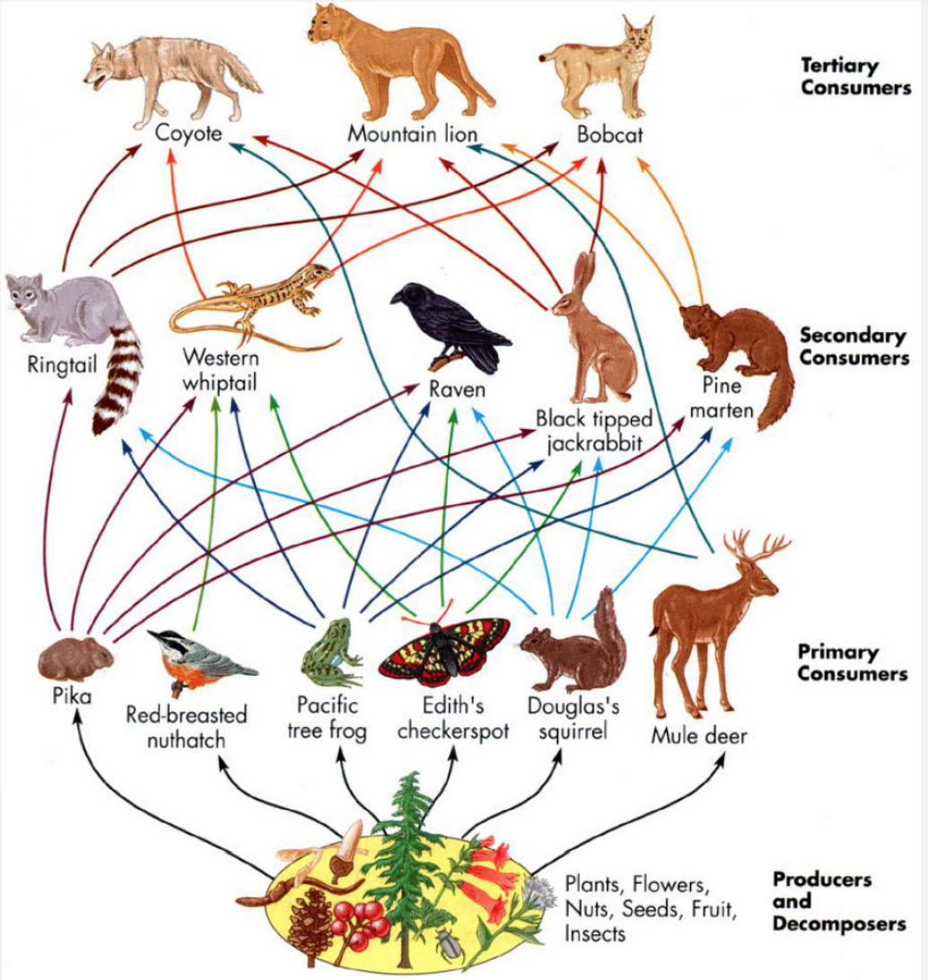
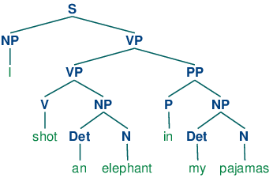
GNN in NLP and CV
Sentiment analysis
[Tai et al. ACL’15]
Knowledge Graph QA
Diagram understanding

Slide 12
Existing frameworks do not support GNNs well
It’s hard to program
It’s hard to get good performance

Slide 13
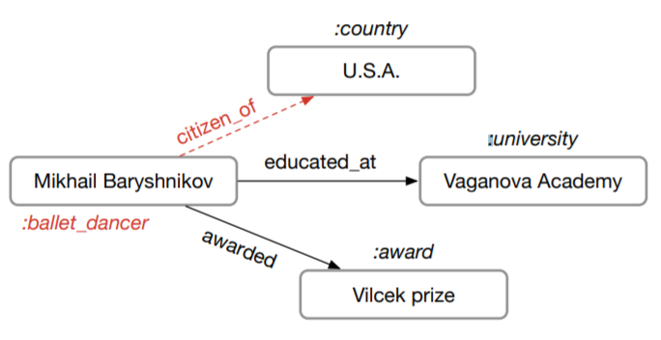
GNNs are often slow in current frameworks
Parse Tree
[Tai et al. ACL’15]
Molecule Graph
[Jin et al. ICML’18]
Knowledge Base
[Schlichtkrull et al. arxiv’17]
Training speed of one popular PyTorch version is only 23 trees/s
Author’s code in PyTorch: 8.25 graphs/s
Cannot run on GPU
due to OOM

Slide 14
What’s the problem?
GNN algorithms are defined in message passing paradigm. A mismatch in the programming model
Have a figure about this

Slide 15
Deep Graph Library (DGL)
User program
DGL automatically enables
Message passing style
Fully customizable
Compatible w/ Pytorch/MXNet
(Sparse) Tensor operations
Auto-batching
Large graph storage

Slide 16
DGL features
Large graph:
Dynamic graph:
Multiple graphs:

Slide 17
Tutorial outline
Basics.ipynb
Create graph with DGL and associate features with nodes and edges
MessagePassing.ipynb
Perform message passing computation on a graph
GCN.ipynb
Implement Graph Convolutional Network
Speedup.ipynb
Speed up with sparse matrix multiplication kernels
BatchGraph.ipynb
Batch execution of multiple graphs, and perform efficient read-out on batch of graphs

Slide 18
DGL’s Message Passing Model
Message phase
V₁
E₁₃
V₃
M₁₃
message_func( , , ) =
V₂
E₂₃
V₃
M₂₃
V₁
1
E₁₃
3
V₃
E₂₃
2
V₂

Slide 19
DGL’s Message Passing Model
Reduce phase
M₁₃
reduce_func( ) =
M₃
M₂₃
V₁
1
E₁₃
3
V₃
E₂₃
2
M₁₃
V₂
M₂₃

Slide 20
DGL’s Message Passing Model
Apply phase
apply_func( , ) =
V₃
M₃
V₃
V₁
1
E₁₃
3
V₃
E₂₃
2
V₂

Slide 21
DGL’s Message Passing API
Define computations over batched of nodes / edges
Send(u, v, message_func)
Recv(v, reduce_func, apply_func)
A batch of edges
Source
Node
Destination
Node
<message>: edges
<apply>: nodes
edges.src
edges.data
edges.dst
<reduce>: nodes
A batch of source nodes
*Mailbox will be emptied after recv call triggers the node UDF.
Mailbox*

Slide 22
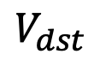
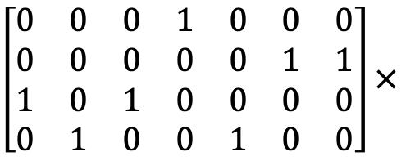
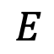
Fuse message passing
If reduce function is sum
Fuse reduce for all nodes into one sparse kernel
M₁₃
M₁₃
$$E$$
M₁₄
M₁₄
M₁
$\left[\begin{matrix}0 & 0 & 0 & 1 & 0 & 0 & 0 \\ 0 & 0 & 0 & 0 & 0 & 1 & 1 \\ 1 & 0 & 1 & 0 & 0 & 0 & 0 \\ 0 & 1 & 0 & 0 & 1 & 0 & 0\end{matrix}\right]×$
M₂₃
M₂₃
M₂
$$V_{dst}$$
M₂₁
M₂₁
M₃
M₃₄
M₃₄
M₄
M₃₂
M₃₂
M₄₂
M₄₂

Slide 23
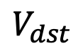
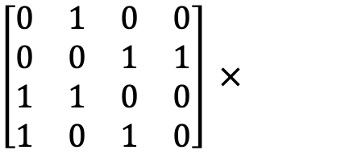
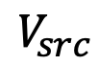
Fuse message passing
If message function copies source node data and reduce function is sum
Fuse message and reduce phase into one sparse kernel
Avoid materializing messages
$$V_{src}$$
V₁
M₁
$\left[\begin{matrix}0 & 1 & 0 & 0 \\ 0 & 0 & 1 & 1 \\ 1 & 1 & 0 & 0 \\ 1 & 0 & 1 & 0\end{matrix}\right] ×$
V₁
V₂
M₂
V₂
$$V_{dst}$$
V₃
M₃
V₃
V₄
M₄
V₄

Slide 24
Batch Multiple Graphs
Concatenate multiple graphs to be one graph with many disjoint connected components
Graph 1
[ ]
Graph 2
=
batch
Graph 1
Graph 2

Slide 25
Resources
DGL website: https://www.dgl.ai/
DGL GitHub Repository: https://github.com/dmlc/dgl
DGL discuss forum: https://discuss.dgl.ai/

Slide 26
Comparison with other systems
 | GraphNets | NGra | Euler | DGL
Active set | ❌ | ❌ | ❌ | ✅
Arbitrary reduce | ✅ | ❌ | ✅ | ✅
Auto-batching of reduce | ❌ | ❌ | ❌ | ✅
Batch multiple graphs | ✅ | ❌ | ❌ | ✅
Kernel fusion | ❌ | ❌ | ❌ | ✅

